Slide 1
Exploratory data-Analysis
Extracting data from the source, analysing it & cleansing of data before operation

Slide 2
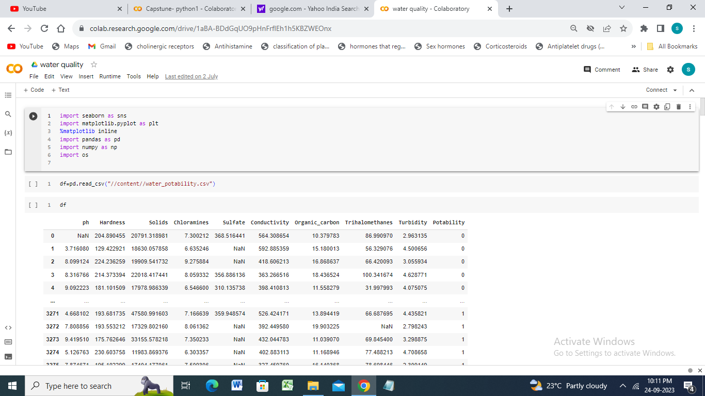

Slide 3
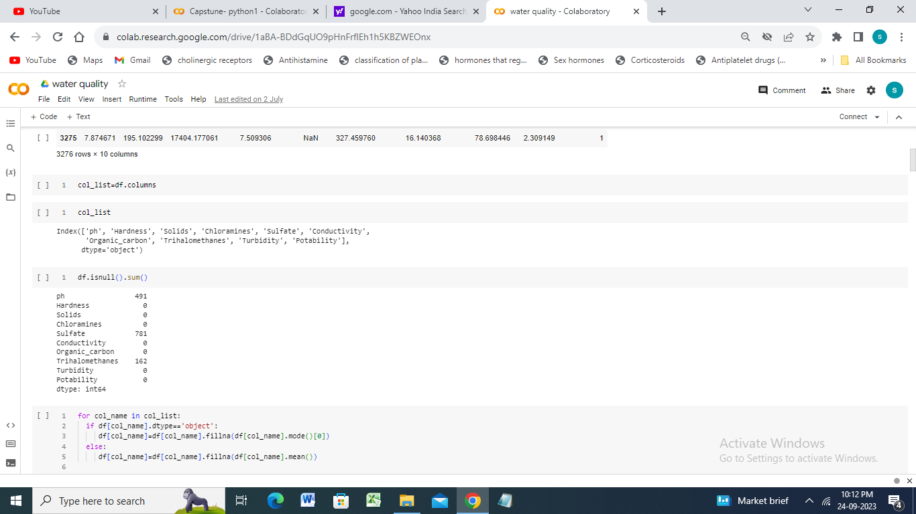

Slide 4
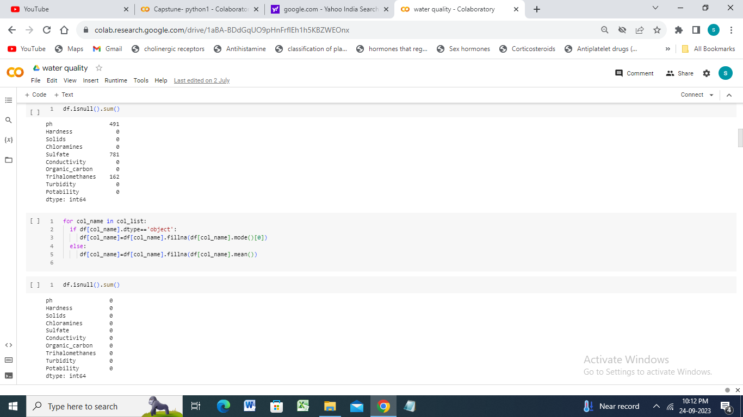

Slide 5
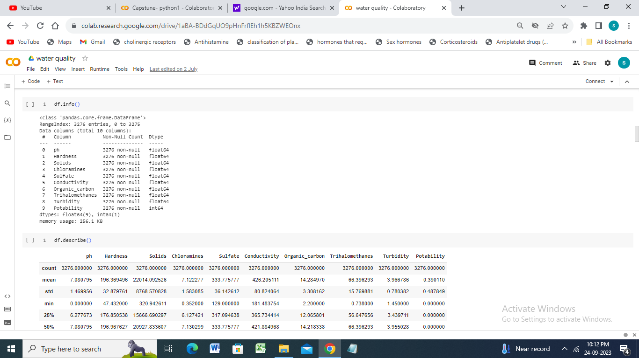

Slide 6
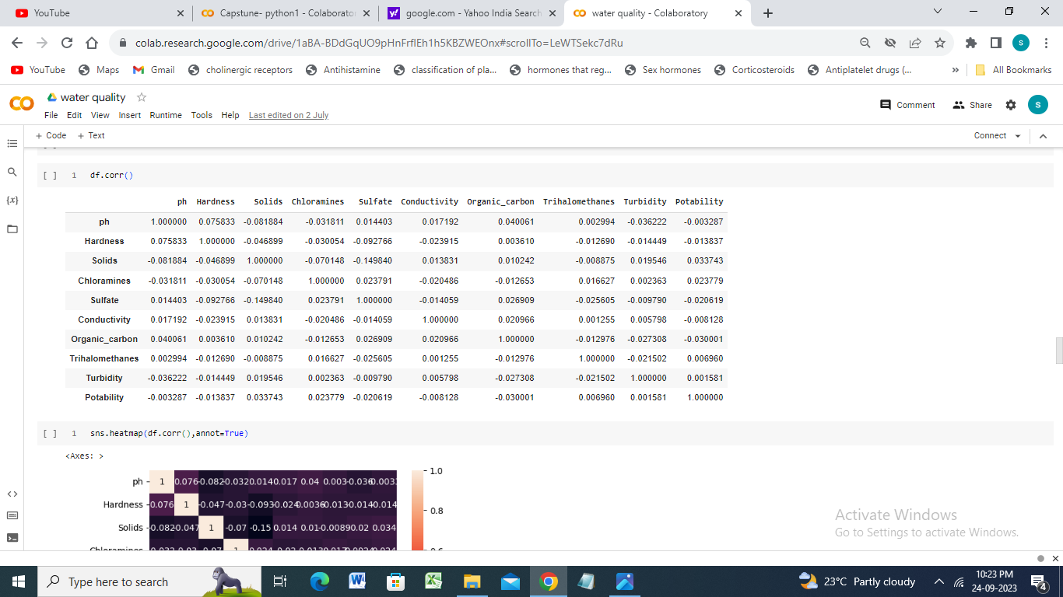

Slide 7
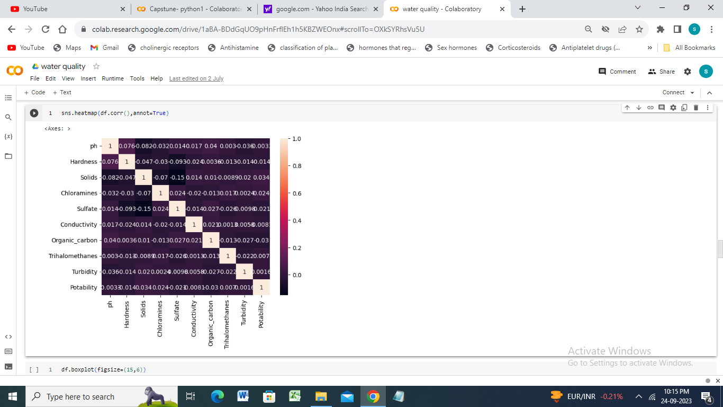

Slide 8
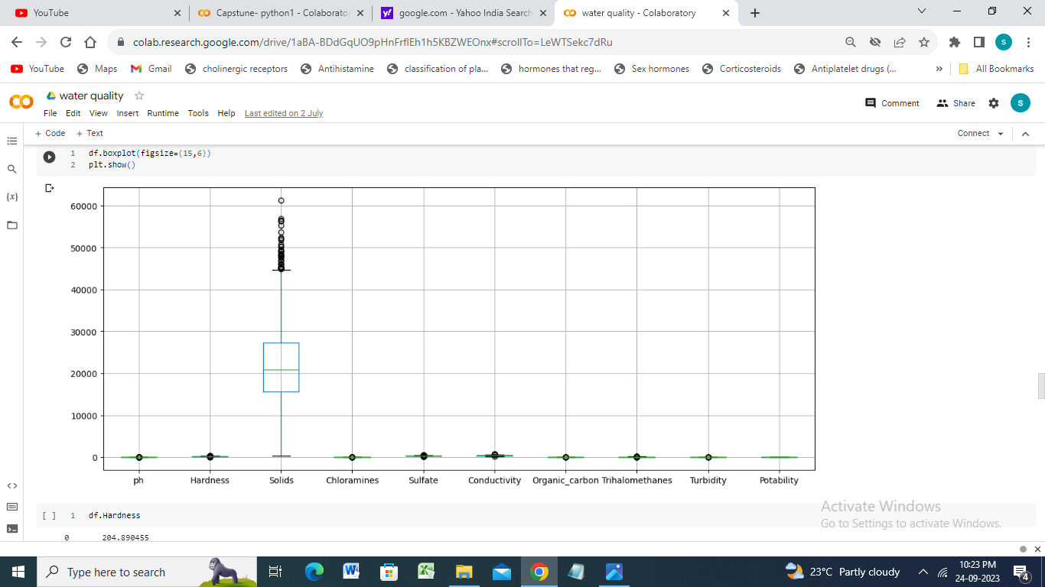

Slide 9
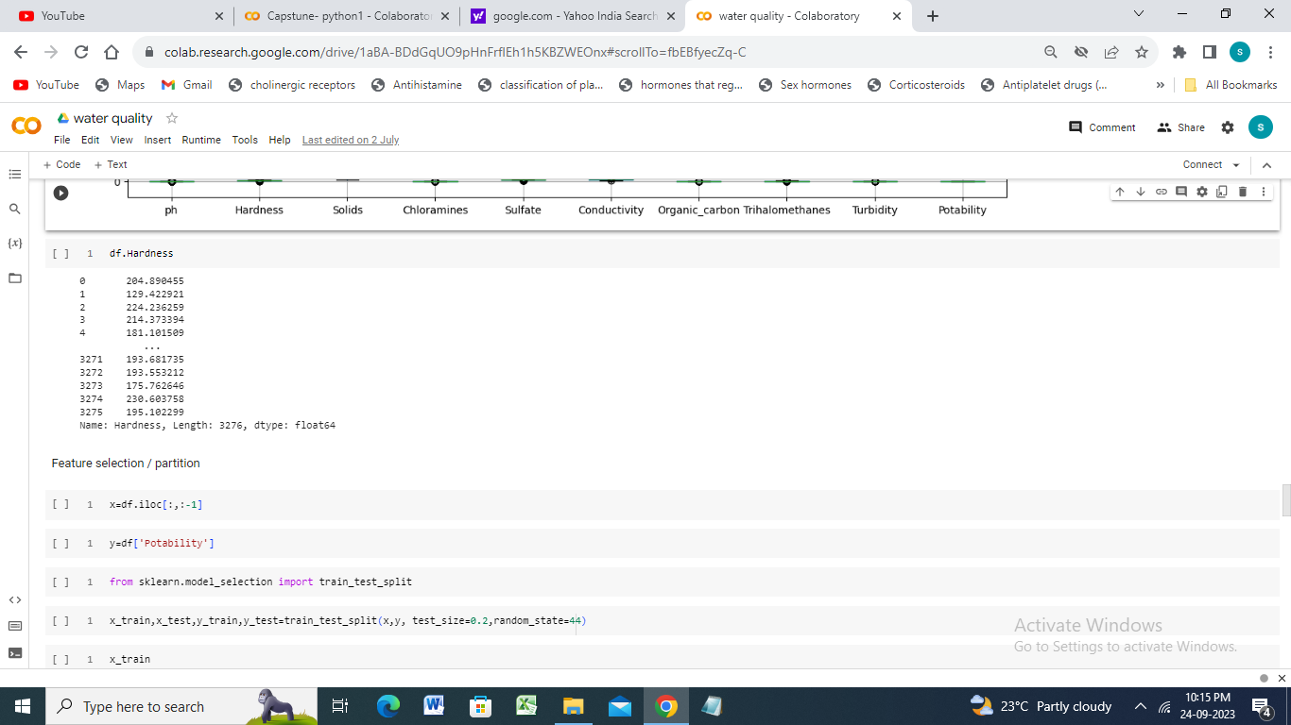

Slide 10
TRAINING & TESTING
Training & Testing of model before prediction

Slide 11
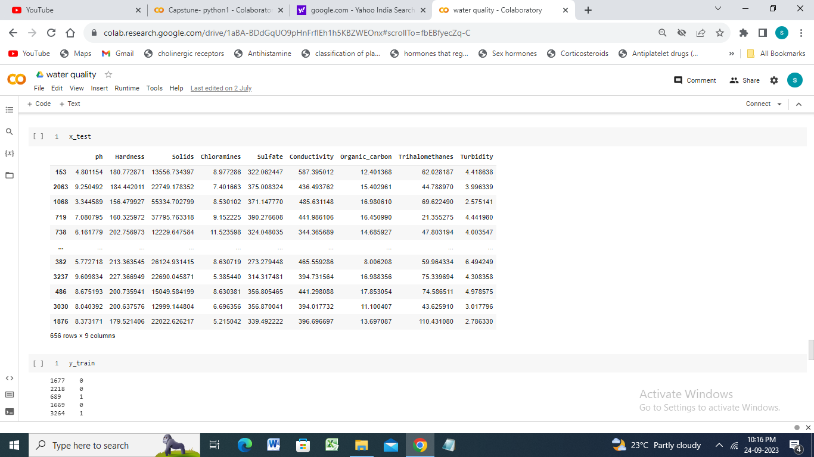

Slide 12
Prediction
Making Prediction of data through decision tree classifier & making a conclusion

Slide 13
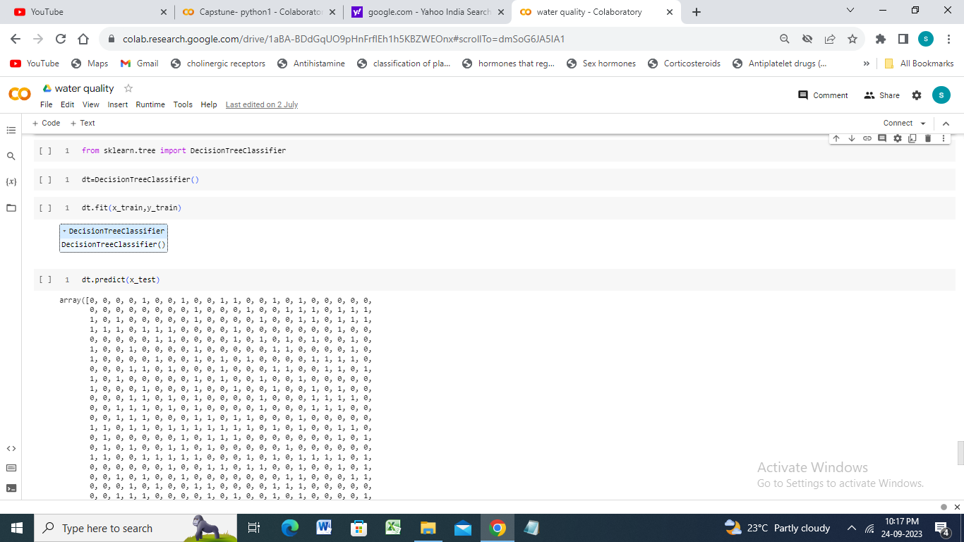

Slide 14
